Slide 1
System Analysis and Design
Assignment 1
Online Affordable Delivery Platform (Mobile Application)
© 2020 Xuanao Zhao, Ryan Cheah, Yong Liang Poo, Tiew Shou Cheng.

Slide 2

Assignment Information
Xuanao Zhao 20023404
Subject Name/Code
System Analysis and Design
DIT2143
Poo Yong Liang 20034864
Lecturer
Ms Kumatha Velli Muruyandy
Ryan Cheah 20018222
Programme / Intake
Diploma In Information Technology (March - 2020)
Tiew Shou Cheng 20038550

Slide 3

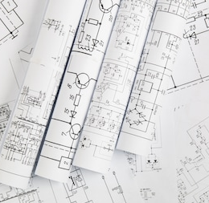
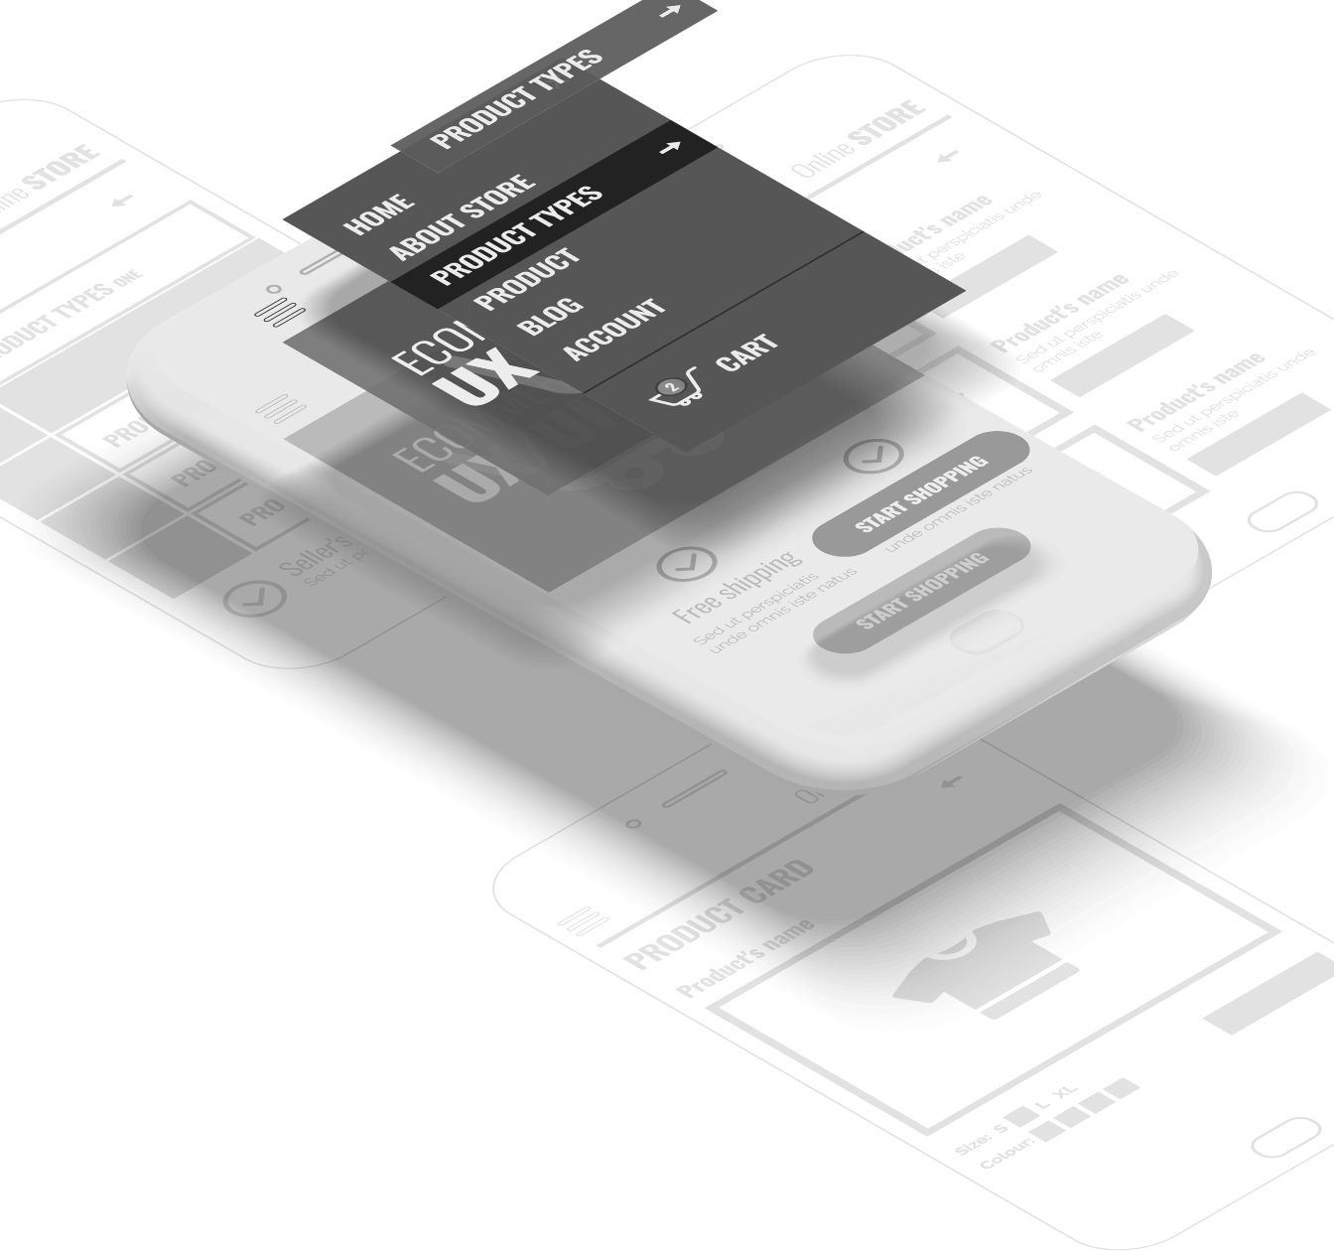
In This Presentation
Background Information
Introduction to the project
Requirements & Design Functional/Non-Functional Requirements, Modeling
UI Design UI Concept and Demos

Slide 4
Background Information
In this section:
Introduction
Objective
User Groups and Other Stakeholders
Background Information Introduction to the project

Slide 5

Background Information
Introduction
Those reliable delivery services are very expensive.
I can’t leave my house; I need to take care of my kids.
Can’t match my delivery time and customer’s delivery time.
Notes:
Where did this idea came from?

Slide 6
Background Information
Objective
User-friendly
Can be easily understood & used by anyone
Reliable
Can be trusted and be sure of what's happening
Convenient
Use it anytime and anywhere

Slide 7
Background Information
User Groups
Sellers
From home; Sells item with short expiration / relatively low in price/quality.
People needs income
People who requires extra income to support daily life

Slide 8
Background Information
Other Stakeholders
Staff & Admins
Monitor the platform, marketing etc.
Developers
Develops & maintain the system

Slide 9
Requirements & Design
In this section:
Requirement by Client
Technical Summery of Functional Requirements
Other Requirements
Requirements & Design Functional/Non-Functional Requirements, Modeling

Slide 10
Requirements & Design
Request by Client
Sender

Slide 11
Request by Client
Sender

Slide 12
Request by Client
Sender

Slide 13
Request by Client
Sender
Receiver
Notes:
Where did this idea came from?

Slide 14
Request by Client
Sender
Receiver

Slide 15
Request by Client
Sender
Receiver
Riders

Slide 16
Request by Client
Request 5
Sender
Receiver
Request 1
Request 2
Request 3
Request 4
Request 5
Riders
Request 6

Slide 17
Request by Client
Request 5
Request 1
Sender
Receiver
Request 2
Request 3
Request 4
Request 5
Request 6
Riders

Slide 18
Request by Client
Request 5
Request 1
Sender
Receiver
Request 2
Request 3
Request 4
Request 5
Request 6
Riders

Slide 19
Request by Client
Sender
Riders
Receiver

Slide 20
Request by Client
Sender
Riders
Receiver

Slide 21
Request by Client
Sender
Receiver

Slide 22
Requirements & Design
Request by Client
Sender
Riders
Receiver

Slide 23
Requirements & Design
Technical Summary
Account System & User Registration
Every user should have an account which they can manage
Post & Manage Delivery Requests
Post, Edit, Remove by Sender
Accept & Manage Accepted Delivery Requests
Accept, Complete, Cancel a request by Rider

Slide 24
Requirements & Design
Other Requirements
Notification of Account Accept/Reject
Get a notification for account being accepted/Rejected
Map for Seller/Rider
Sender can track the Rider; Rider can follow the GPS to destination
Messaging/Calling feature.
Rider and Sender can contact by messaging and calling feature provided

Slide 25
Requirements & Design
Non-functional Requirements
User Interface
User interface designed to suit the situation
Reliability
Data should be synced to a backup server in case of the main server down
Performance
Requests Operations should at least be done within 10 seconds
Security
Password authentication will be required for using this system

Slide 26
Requirements & Design
System Modeling
Delivery Platform for Seller/Riders
Registration
User
<< i >>
Admin
Update Personal Information
Verification of Registration
Post Request
Edit Request
<< e >>
Sender
Manage Requests
<< e >>
Remove Request
Accept Requests
Rider
Complete Requests
Cancel Request

Slide 27
Requirements & Design
System Modeling
Delivery Platform for Seller/Riders
User Account
Registration
Account ID
Username
User
<< i >>
Admin
Password
Update Personal Information
Verification of Registration
Email Address
Post Request
Rider
Sender
1 .. *
1
Store
Edit Request
Vehicle Info
Store ID
<< e >>
1 .. *
Store Address
Sender
Manage Requests
1 .. *
Remove Request
Store Description
<< e >>
Request
Accept Requests
1
Request ID
DateTime
1
Rider
Complete Requests
Destination
Cancel Request

Slide 28
Requirements & Design
System Modeling
Use case name | Registration
Scenario | New user wants to join the platform by creating a new user-account
Triggering Event | Select Create Account in Menu
Brief description | Users either create a sender-account/rider-account by entering their basic information and vehicle information if necessary.
Actors | User, Admin
Stakeholders | Platform’s User management, User
Preconditions | Make sure user is not repeating the registration
Postconditions | New user accounts must be saved in the database. User information must be validate
Flow of activities | User (Actor 1) | Admin (Actor 2) | System
 | User enter basic information |  | 1.1 Validate user information 1.2 Check if its rider
 | 2. User enter vehicle information (only if rider)
 |  | 3. Admin verifies vehicle information | 3.1 Updates database and save new account information
Exception Conditions | 1.1: User information not valid 3: Admin reject user registration
Delivery Platform for Seller/Riders
Registration
User
<< i >>
Admin
Update Personal Information
Verification of Registration
Post Request
Edit Request
<< e >>
Sender
Manage Requests
<< e >>
Remove Request
Accept Requests
Rider
Complete Requests
Cancel Request

Slide 29
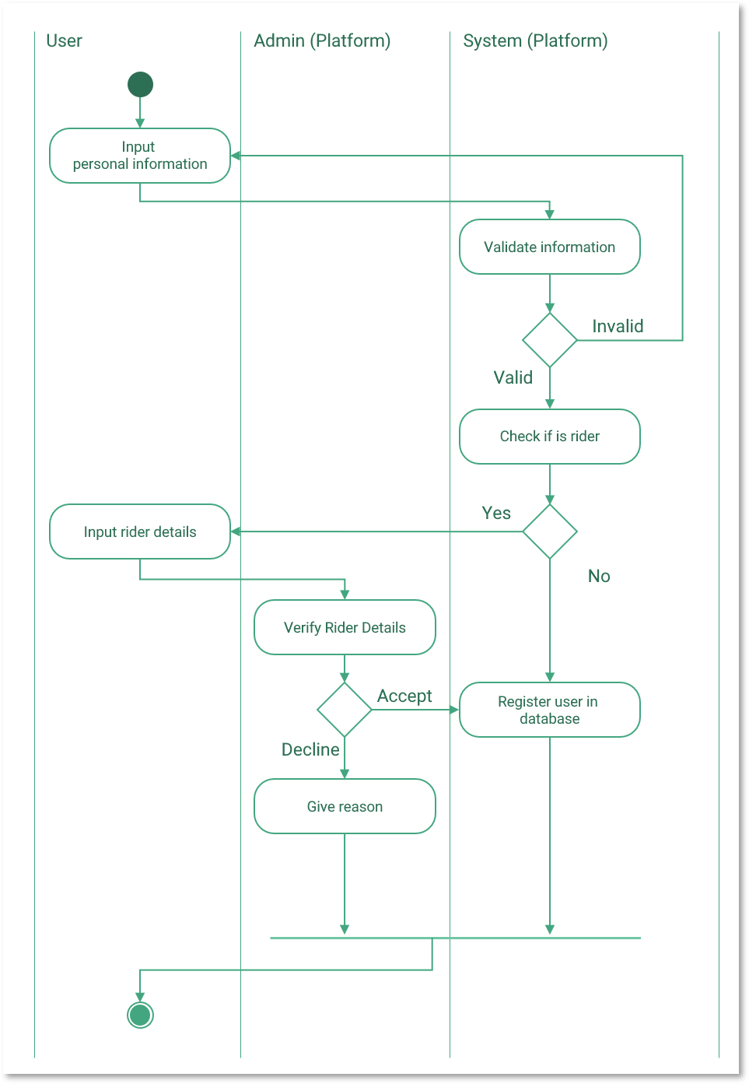
Requirements & Design
System Modeling
Delivery Platform for Seller/Riders
Registration
User
<< i >>
Admin
Update Personal Information
Verification of Registration
Post Request
Edit Request
<< e >>
Sender
Manage Requests
<< e >>
Remove Request
Accept Requests
Rider
Complete Requests
Cancel Request

Slide 30
Requirements & Design
System Modeling
Delivery Platform for Seller/Riders
Registration
User
<< i >>
Admin
Update Personal Information
Verification of Registration
Post Request
Edit Request
<< e >>
Sender
Manage Requests
<< e >>
Remove Request
Accept Requests
Rider
Complete Requests
Cancel Request

Slide 31
Requirements & Design
System Modeling
Delivery Platform for Seller/Riders
Use case name | Update personal information.
Scenario | When a user wishes to update their personal information (name, email, password etc).
Triggering Event | User selects Update My Information in the settings menu.
Brief description | Users update their personal information by entering new information.
Actors | User
Stakeholders | Platform’s User Management, User
Preconditions | None
Postconditions | New information has to be valid New information must be updated in the database.
Flow of activities | User (Actor) | System
 | 1. Select an information to change
 | 2. Enter a new information | 2.1 Validate entered information
Exception Conditions | 1. Information unchangeable (Date of birth, IC Number) 2.1 Information invalid
Registration
User
<< i >>
Admin
Update Personal Information
Verification of Registration
Post Request
Edit Request
<< e >>
Sender
Manage Requests
<< e >>
Remove Request
Accept Requests
Rider
Complete Requests
Cancel Request

Slide 32
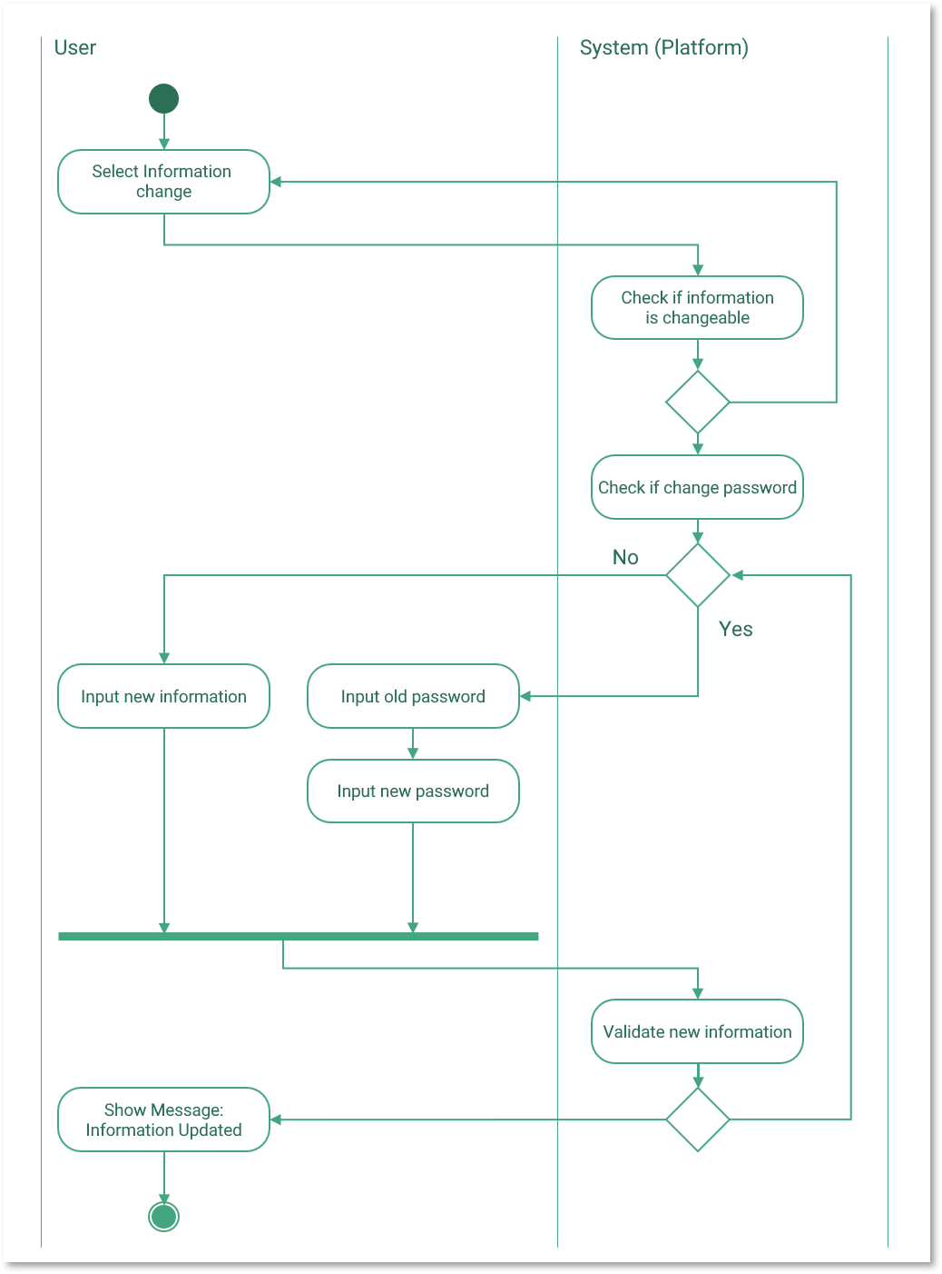
Requirements & Design
System Modeling
Delivery Platform for Seller/Riders
Registration
User
<< i >>
Admin
Update Personal Information
Verification of Registration
Post Request
Edit Request
<< e >>
Sender
Manage Requests
<< e >>
Remove Request
Accept Requests
Rider
Complete Requests
Cancel Request

Slide 33
Requirements & Design
System Modeling
Delivery Platform for Seller/Riders
Registration
User
<< i >>
Admin
Update Personal Information
Verification of Registration
Post Request
Edit Request
<< e >>
Sender
Manage Requests
<< e >>
Remove Request
Accept Requests
Rider
Complete Requests
Cancel Request

Slide 34
Requirements & Design
System Modeling
Delivery Platform for Seller/Riders
Use case name | Post Requests
Scenario | When a user wishes a rider can come and pick up some items and deliver to a relatively nearby destination
Triggering Event | Sender selects the Post Request button from the menu.
Brief description | Senders post a “Delivery Request” by selecting a start point (a store) and entering a destination address.
Actors | Sender
Stakeholders | User (Sender, Rider)
Preconditions | None
Postconditions | Requests should be open for riders who are nearby the selected starting point.
Flow of activities | Sender (Actor) | System (Actor)
 | 1. Select a starting point and destination address | 1.1 Validate destination address 1.2 Generate a new request
Exception Conditions | 1.1 Destination address invalid
Registration
User
<< i >>
Admin
Update Personal Information
Verification of Registration
Post Request
Edit Request
<< e >>
Sender
Manage Requests
<< e >>
Remove Request
Accept Requests
Rider
Complete Requests
Cancel Request

Slide 35
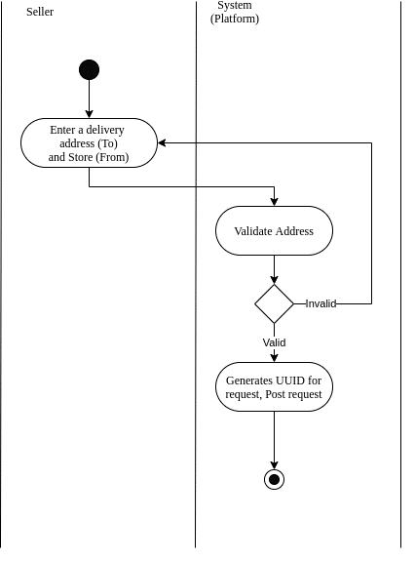
Requirements & Design
System Modeling
Delivery Platform for Seller/Riders
Registration
User
<< i >>
Admin
Update Personal Information
Verification of Registration
Post Request
Edit Request
<< e >>
Sender
Manage Requests
<< e >>
Remove Request
Accept Requests
Rider
Complete Requests
Cancel Request

Slide 36
Requirements & Design
System Modeling
Delivery Platform for Seller/Riders
Use case name | Manage Request (Edit, Remove).
Scenario | When a user wishes to update their posted request (Starting point, destination).
Triggering Event | Sender select edit button for a certain request
Brief description | Sender modifies the address, starting point by selecting a new address or starting point, or removes the request.
Actors | Sender, Rider
Stakeholders | Users (Sender, Rider)
Preconditions | Request must exist
Postconditions | Request must be updated If the request is being accepted, the modification must be notified to the rider.
Flow of activities | Sender (Actor 1) | Rider (Actor 2) | System
 | 1. Select edit or remove, and type in a new information if edit |  | 1.1 Validate information 1.2 See if any rider accept 1.3 Establish communication between Rider & Sender
 |  | 2. Accept changes | 2.1 Update the changes in system/Database
Exception Conditions | 1.1 Information invalid 2. Rider do not accept the changes
Registration
User
<< i >>
Admin
Update Personal Information
Verification of Registration
Post Request
Edit Request
<< e >>
Sender
Manage Requests
<< e >>
Remove Request
Accept Requests
Rider
Complete Requests
Cancel Request

Slide 37

Requirements & Design
System Modeling
Delivery Platform for Seller/Riders
Registration
User
<< i >>
Admin
Update Personal Information
Verification of Registration
Post Request
Edit Request
<< e >>
Sender
Manage Requests
<< e >>
Remove Request
Accept Requests
Rider
Complete Requests
Cancel Request

Slide 38
Requirements & Design
System Modeling
Delivery Platform for Seller/Riders
Registration
User
<< i >>
Admin
Update Personal Information
Verification of Registration
Post Request
Edit Request
<< e >>
Sender
Manage Requests
<< e >>
Remove Request
Accept Requests
Rider
Complete Requests
Cancel Request

Slide 39
Requirements & Design
System Modeling
Delivery Platform for Seller/Riders
Use case name | Accept Request
Scenario | Rider wishes to accept a delivery request
Triggering Event | Rider select an available request and select accept request
Brief description | Rider accepts a delivery request by selecting the accept option of an request
Actors | Rider
Stakeholders | Rider, Sender
Preconditions | Request is not being accepted by anyone else Request is nearby
Postconditions | No other rider should be able to accept the same request
Flow of activities | Rider (Actor) | System
 | 1. Select accept request option | 1.1 Send notification to sender: Request being accepted
Exception Conditions | None
Registration
User
<< i >>
Admin
Update Personal Information
Verification of Registration
Post Request
Edit Request
<< e >>
Sender
Manage Requests
<< e >>
Remove Request
Accept Requests
Rider
Complete Requests
Cancel Request

Slide 40
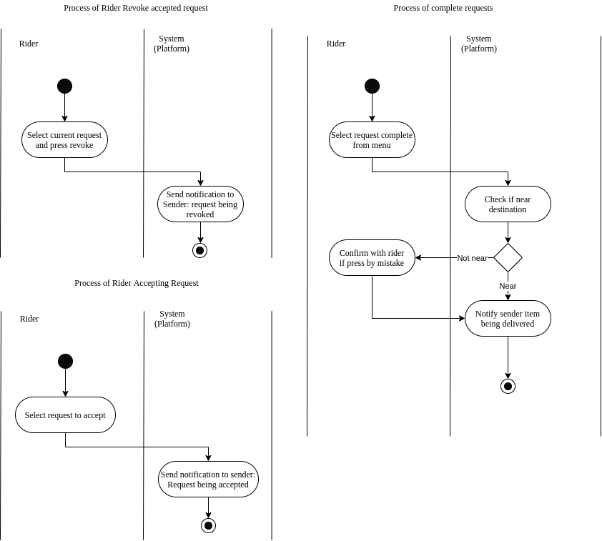
Requirements & Design
System Modeling
Delivery Platform for Seller/Riders
Registration
User
<< i >>
Admin
Update Personal Information
Verification of Registration
Post Request
Edit Request
<< e >>
Sender
Manage Requests
<< e >>
Remove Request
Accept Requests
Rider
Complete Requests
Cancel Request

Slide 41
Requirements & Design
System Modeling
Delivery Platform for Seller/Riders
Use case name | Complete Request
Scenario | When items are being delivered and the rider wishes to update the status of the request.
Triggering Event | Rider selects the complete request option.
Brief description | Rider completes the request by selecting the complete option
Actors | Rider
Stakeholders | Users (Rider, Sender), Receiver
Preconditions | Request is being accepted by the rider (Actor).
Postconditions | Request status should be updated and saved in the system/database.
Flow of activities | Rider (Actor) | System
 | 1. Select complete request. | 1.1 Checks if near destination on GPS
 | 2. Confirm completion if required | 2.1 Notify sender item being delivered
Exception Conditions | None
Registration
User
<< i >>
Admin
Update Personal Information
Verification of Registration
Post Request
Edit Request
<< e >>
Sender
Manage Requests
<< e >>
Remove Request
Accept Requests
Rider
Complete Requests
Cancel Request

Slide 42
Requirements & Design
System Modeling
Delivery Platform for Seller/Riders
Registration
User
<< i >>
Admin
Update Personal Information
Verification of Registration
Post Request
Edit Request
<< e >>
Sender
Manage Requests
<< e >>
Remove Request
Accept Requests
Rider
Complete Requests
Cancel Request

Slide 43
Requirements & Design
System Modeling
Delivery Platform for Seller/Riders
Use case name | Revoke/Cancel Accepted Request
Scenario | Rider wishes to drop/cancel an accepted delivery request
Triggering Event | Rider select the accepted request and press revoke/cancel button
Brief description | Rider revokes an accepted request.
Actors | Rider
Stakeholders | Rider, Sender
Preconditions | Request is being accepted
Postconditions | Request status must be updated and saved in system/database
Flow of activities | Rider (Actor) | System
 | 1. Select revoke/cancel option | 1.1 Send notification to sender: Request being canceled
Exception Conditions | None
Registration
User
<< i >>
Admin
Update Personal Information
Verification of Registration
Post Request
Edit Request
<< e >>
Sender
Manage Requests
<< e >>
Remove Request
Accept Requests
Rider
Complete Requests
Cancel Request

Slide 44
Requirements & Design
System Modeling
Delivery Platform for Seller/Riders
Registration
User
<< i >>
Admin
Update Personal Information
Verification of Registration
Post Request
Edit Request
<< e >>
Sender
Manage Requests
<< e >>
Remove Request
Accept Requests
Rider
Complete Requests
Cancel Request

Slide 45
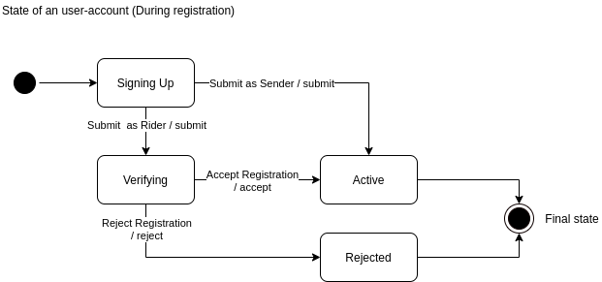
Requirements & Design
System Modeling
User Account
Account ID
Username
Password
Email Address
Rider
Sender
1 .. *
1
Store
Vehicle Info
Store ID
1 .. *
Store Address
1 .. *
Store Description
Request
1
Request ID
DateTime
1
Destination

Slide 46
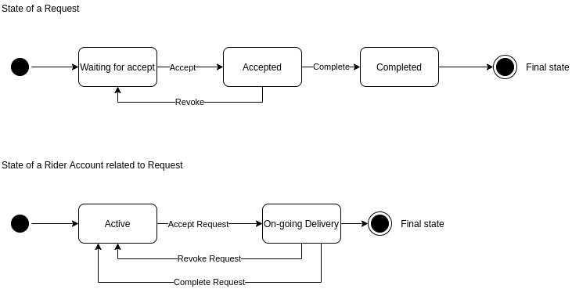
Requirements & Design
System Modeling
User Account
Account ID
Username
Password
Email Address
Rider
Sender
1 .. *
1
Store
Vehicle Info
Store ID
1 .. *
Store Address
1 .. *
Store Description
Request
1
Request ID
DateTime
1
Destination

Slide 47
Requirements & Design
System Modeling
User Account
Account ID
Username
Password
Email Address
Rider
Sender
1 .. *
1
Store
Vehicle Info
Store ID
1 .. *
Store Address
1 .. *
Store Description
Request
1
Request ID
DateTime
1
Destination

Slide 48
UI Design
In this section:
User Interface Design
Demos of User Experiences
UI Design UI Concept and Demos

Slide 49
UI Design
UI/UX Design & Demo
Login/Registration Form
Registration for Rider
Registration Successful/Rejected
Edit Personal Information
Sender Post Requests
Sender Manage Requests
Rider Accepts Requests
Rider Manage Accepted Requests
Notes:
Where did this idea came from?

Slide 50
UI/UX Design & Demo
Login/Registration Form
Registration for Rider
Registration Successful/Rejected
Edit Personal Information
Sender Post Requests
Sender Manage Requests
Rider Accepts Requests
Rider Manage Accepted Requests
16:9

Slide 51
UI/UX Design & Demo
Logo
Login/Registration Form
Registration for Rider
Registration Successful/Rejected
Edit Personal Information
Sender Post Requests
Sender Manage Requests
Rider Accepts Requests
Rider Manage Accepted Requests
Username
Password
Login
Swipe up to Register
Username
E-mail
Password
Re-Enter Password
I’m a …
Sender
Rider
Next

Slide 52
UI/UX Design & Demo
Swipe up to Register
Logo
Login/Registration Form
Registration for Rider
Registration Successful/Rejected
Edit Personal Information
Sender Post Requests
Sender Manage Requests
Rider Accepts Requests
Rider Manage Accepted Requests
Username
E-mail
Username
Password
Password
Re-Enter Password
Login
I’m a …
Sender
Rider
Next

Slide 53
UI/UX Design & Demo
Swipe up to Register
Logo
Login/Registration Form
Registration for Rider
Registration Successful/Rejected
Edit Personal Information
Sender Post Requests
Sender Manage Requests
Rider Accepts Requests
Rider Manage Accepted Requests
Username
John
E-mail
John123@example.com
Username
Password
••••••••••••
Password
Re-Enter Password
••••••••••
Login
I’m a …
Sender
Rider
Next

Slide 54
UI/UX Design & Demo
Swipe up to Register
Logo
Login/Registration Form
Registration for Rider
Registration Successful/Rejected
Edit Personal Information
Sender Post Requests
Sender Manage Requests
Rider Accepts Requests
Rider Manage Accepted Requests
Username
John
E-mail
John123@example.com
Username
Password
••••••••••••
Password
Re-Enter Password
••••••••••
Login
I’m a …
Sender
Rider
Multiple fields are incorrect
Next

Slide 55
UI/UX Design & Demo
Swipe up to Register
Logo
Login/Registration Form
Registration for Rider
Registration Successful/Rejected
Edit Personal Information
Sender Post Requests
Sender Manage Requests
Rider Accepts Requests
Rider Manage Accepted Requests
Username
John
E-mail
John123@example.com
Username
Password
••••••••••••
Password
Re-Enter Password
••••••••••••
Login
I’m a …
Sender
Rider
Next

Slide 56
UI/UX Design & Demo
Swipe up to Register
Logo
Login/Registration Form
Registration for Rider
Registration Successful/Rejected
Edit Personal Information
Sender Post Requests
Sender Manage Requests
Rider Accepts Requests
Rider Manage Accepted Requests
Username
John
E-mail
John123@example.com
Password
Username
••••••••••••
Password
Re-Enter Password
You’re Complete!
••••••••••••
Press ‘Done’ and proceed to login page.
Login
I’m a …
Sender
Rider
Done

Slide 57
UI/UX Design & Demo
Swipe up to Register
Logo
Login/Registration Form
Registration for Rider
Registration Successful/Rejected
Edit Personal Information
Sender Post Requests
Sender Manage Requests
Rider Accepts Requests
Rider Manage Accepted Requests
Username
John
E-mail
John123@example.com
Username
Password
••••••••••••
Password
Re-Enter Password
••••••••••••
Login
I’m a …
Sender
Rider
Next

Slide 58
UI/UX Design & Demo
Swipe up to Register
Logo
Login/Registration Form
Registration for Rider
Registration Successful/Rejected
Edit Personal Information
Sender Post Requests
Sender Manage Requests
Rider Accepts Requests
Rider Manage Accepted Requests
Username
Please complete the rider information
John
E-mail
Vehicle Description (Model, Color)
John123@example.com
Password
Username
••••••••••••
Vehicle Plate No.
Re-Enter Password
Password
••••••••••••
Login
I’m a …
Sender
Rider
Next

Slide 59
UI/UX Design & Demo
Swipe up to Register
Logo
Login/Registration Form
Registration for Rider
Registration Successful/Rejected
Edit Personal Information
Sender Post Requests
Sender Manage Requests
Rider Accepts Requests
Rider Manage Accepted Requests
Please complete the rider information
Vehicle Description (Model, Color)
CMC ARIO 110, Black
Vehicle Plate No.
Username
ABC 1234
Password
Login
Next

Slide 60
UI/UX Design & Demo
Swipe up to Register
Logo
Login/Registration Form
Registration for Rider
Registration Successful/Rejected
Edit Personal Information
Sender Post Requests
Sender Manage Requests
Rider Accepts Requests
Rider Manage Accepted Requests
Please complete the rider information
Vehicle Description (Model, Color)
CMC ARIO 110, Black
Vehicle Plate No.
Username
ABC 1234
Password
You’re Complete for now
Please wait for the admin to verify your vehicle
Login
Done

Slide 61
UI/UX Design & Demo
Login/Registration Form
Registration for Rider
Registration Successful/Rejected
Edit Personal Information
Sender Post Requests
Sender Manage Requests
Rider Accepts Requests
Rider Manage Accepted Requests

Slide 62


UI/UX Design & Demo
Login/Registration Form
Registration for Rider
Registration Successful/Rejected
Edit Personal Information
Sender Post Requests
Sender Manage Requests
Rider Accepts Requests
Rider Manage Accepted Requests
XXX Delivery System • 12:30
Logo
Your registration has been approved
Press this message for more details
12:30
23/9/2020, Wed

Slide 63
UI/UX Design & Demo
Login/Registration Form
Registration for Rider
Registration Successful/Rejected
Edit Personal Information
Sender Post Requests
Sender Manage Requests
Rider Accepts Requests
Rider Manage Accepted Requests
You’re registration has been
approved
Press ‘Done’ to login.
Done

Slide 64
UI/UX Design & Demo
Login/Registration Form
Registration for Rider
Registration Successful/Rejected
Edit Personal Information
Sender Post Requests
Sender Manage Requests
Rider Accepts Requests
Rider Manage Accepted Requests
You’re registration has been rejected
Your vehicle information is invalid. Press ‘Done’ to register again.
Done

Slide 65
UI/UX Design & Demo
Logo
Login/Registration Form
Registration for Rider
Registration Successful/Rejected
Edit Personal Information
Sender Post Requests
Sender Manage Requests
Rider Accepts Requests
Rider Manage Accepted Requests
Username
Password
Login
Swipe up to Register

Slide 66
UI/UX Design & Demo
Logo
Login/Registration Form
Registration for Rider
Registration Successful/Rejected
Edit Personal Information
Sender Post Requests
Sender Manage Requests
Rider Accepts Requests
Rider Manage Accepted Requests
Username
John
Password
••••••••••••
Login
Swipe up to Register

Slide 67

UI/UX Design & Demo
Home
John
Rider
Welcome Back,
John1213
Login/Registration Form
Registration for Rider
Registration Successful/Rejected
Edit Personal Information
Sender Post Requests
Sender Manage Requests
Rider Accepts Requests
Rider Manage Accepted Requests
Request History
About
12:34 PM
Cloudy
Post Request
Manage Requests
3 active requests

Slide 68
UI/UX Design & Demo
Home
John
Rider
Welcome Back,
John1213
Login/Registration Form
Registration for Rider
Registration Successful/Rejected
Edit Personal Information
Sender Post Requests
Sender Manage Requests
Rider Accepts Requests
Rider Manage Accepted Requests
Change password
Post Request
Change Email
View currently active history
12:34 PM
Change Vehicle Information
Cloudy
Request History
About
Post Request
Manage Requests
3 active requests

Slide 69
UI/UX Design & Demo
Home
John1213
Rider
Welcome Back,
John1213
Login/Registration Form
Registration for Rider
Registration Successful/Rejected
Edit Personal Information
Sender Post Requests
Sender Manage Requests
Rider Accepts Requests
Rider Manage Accepted Requests
Change password
Post Request
Change Email
View currently active history
12:34 PM
Change Vehicle Information
Cloudy
Request History
About
Post Request
Manage Requests
3 active requests

Slide 70





UI/UX Design & Demo
Home
Upload an image
John1213
Rider
Active Requests
Login/Registration Form
Registration for Rider
Registration Successful/Rejected
Edit Personal Information
Sender Post Requests
Sender Manage Requests
Rider Accepts Requests
Rider Manage Accepted Requests
Manage currently active requests
Change password
Post Request
Change Email
View currently active history
Change Vehicle Information
Request History
About

Slide 71

UI/UX Design & Demo
Home
John1213
Rider
Welcome Back,
John1213
Login/Registration Form
Registration for Rider
Registration Successful/Rejected
Edit Personal Information
Sender Post Requests
Sender Manage Requests
Rider Accepts Requests
Rider Manage Accepted Requests
Change password
Change Email
12:34 PM
Change Vehicle Information
Cloudy
Request History
About
Post Request
Manage Requests
3 active requests

Slide 72
UI/UX Design & Demo
Home
John1213
Rider
Welcome Back,
John1213
Login/Registration Form
Registration for Rider
Registration Successful/Rejected
Edit Personal Information
Sender Post Requests
Sender Manage Requests
Rider Accepts Requests
Rider Manage Accepted Requests
Change password
Post Request
Change Email
View currently active history
12:34 PM
John@example.com
Cloudy
Change Vehicle Information
Request History
About
Post Request
Manage Requests
3 active requests

Slide 73
UI/UX Design & Demo
Home
John1213
Rider
Welcome Back,
John1213
Login/Registration Form
Registration for Rider
Registration Successful/Rejected
Edit Personal Information
Sender Post Requests
Sender Manage Requests
Rider Accepts Requests
Rider Manage Accepted Requests
Change password
Change Email
12:34 PM
John1213@
Cloudy
Change Vehicle Information
Request History
About
Post Request
Manage Requests
3 active requests

Slide 74
UI/UX Design & Demo
Home
John1213
Rider
Welcome Back,
John1213
Login/Registration Form
Registration for Rider
Registration Successful/Rejected
Edit Personal Information
Sender Post Requests
Sender Manage Requests
Rider Accepts Requests
Rider Manage Accepted Requests
Change password
Post Request
Change Email
View currently active history
12:34 PM
John1213@
Cloudy
Change Vehicle Information
Request History
About
Post Request
Manage Requests
3 active requests

Slide 75
UI/UX Design & Demo
Home
John1213
Rider
Welcome Back,
John1213
Login/Registration Form
Registration for Rider
Registration Successful/Rejected
Edit Personal Information
Sender Post Requests
Sender Manage Requests
Rider Accepts Requests
Rider Manage Accepted Requests
Change password
Post Request
Change Email
View currently active history
12:34 PM
John1213@example.com
Cloudy
Change Vehicle Information
Request History
About
Post Request
Manage Requests
3 active requests

Slide 76
UI/UX Design & Demo
Home
John1213
Rider
Welcome Back,
John1213
Login/Registration Form
Registration for Rider
Registration Successful/Rejected
Edit Personal Information
Sender Post Requests
Sender Manage Requests
Rider Accepts Requests
Rider Manage Accepted Requests
Request History
About
12:34 PM
Cloudy
Post Request
Manage Requests
3 active requests

Slide 77
UI/UX Design & Demo
John1213
Home
Rider
Welcome Back,
John1213
Login/Registration Form
Registration for Rider
Registration Successful/Rejected
Edit Personal Information
Sender Post Requests
Sender Manage Requests
Rider Accepts Requests
Rider Manage Accepted Requests
Request History
About
12:34 PM
Cloudy
Post Request
Manage Requests
3 active requests

Slide 78
UI/UX Design & Demo
Post Requests
Welcome Back,
John1213
Sender Information
Login/Registration Form
Registration for Rider
Registration Successful/Rejected
Edit Personal Information
Sender Post Requests
Sender Manage Requests
Rider Accepts Requests
Rider Manage Accepted Requests
Select a Store …
12:34 PM
Receiver Information
Cloudy
Address Line 1
Address Line 2
Post Request
Post
Manage Requests
3 active requests

Slide 79
UI/UX Design & Demo
John1213
Post Requests
Rider
Sender Information
Login/Registration Form
Registration for Rider
Registration Successful/Rejected
Edit Personal Information
Sender Post Requests
Sender Manage Requests
Rider Accepts Requests
Rider Manage Accepted Requests
Request History
MyStore – Shah Alam
About
No2, Jalan Prima A23/D, Kemuning Utama, Shah Alam
Receiver Information
Address Line 1
Address Line 2
Post

Slide 80
UI/UX Design & Demo
John1213
Post Requests
Rider
Sender Information
Login/Registration Form
Registration for Rider
Registration Successful/Rejected
Edit Personal Information
Sender Post Requests
Sender Manage Requests
Rider Accepts Requests
Rider Manage Accepted Requests
Request History
MyStore – Shah Alam
About
No2, Jalan Prima A23/D, Kemuning Utama, Shah Alam
Receiver Information
Address Line 1
No28
Address Line 2
Jalan Example 48/32
Post

Slide 81
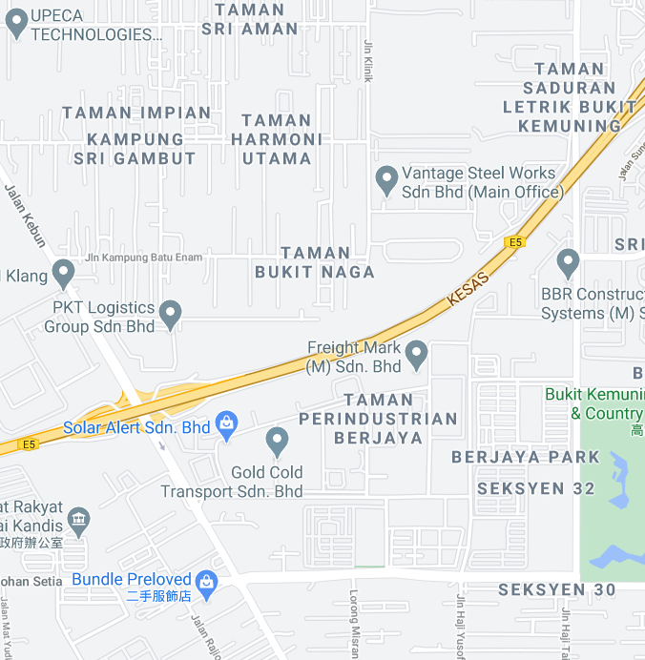
UI/UX Design & Demo
Manage Requests
Sender Information
Login/Registration Form
Registration for Rider
Registration Successful/Rejected
Edit Personal Information
Sender Post Requests
Sender Manage Requests
Rider Accepts Requests
Rider Manage Accepted Requests
Request History
MyStore – Shah Alam
About
No2, Jalan Prima A23/D, Kemuning Utama, Shah Alam
MyStore – Shah Alam
Receiver Information
No28, Jalan Example 48/32
Address Line 1
No28
Address Line 2
Request #1
Jalan Example 48/32
MyStore – Shah Alam
Post
No28, Jalan Example 48/32
Waiting for Rider …

Slide 82
UI/UX Design & Demo
John1213
Home
Rider
Welcome Back,
John1213
Login/Registration Form
Registration for Rider
Registration Successful/Rejected
Edit Personal Information
Sender Post Requests
Sender Manage Requests
Rider Accepts Requests
Rider Manage Accepted Requests
Request History
About
12:34 PM
Cloudy
Post Request
Manage Requests
3 active requests

Slide 83
UI/UX Design & Demo
John1213
Manage Requests
Rider
Request #1
Login/Registration Form
Registration for Rider
Registration Successful/Rejected
Edit Personal Information
Sender Post Requests
Sender Manage Requests
Rider Accepts Requests
Rider Manage Accepted Requests
Rider has accepted
Request History
MyStore – Shah Alam
No34, Jalan Example 49/32
About
Request #2
Rider has accepted
MyStore – Shah Alam
No3, Jalan Example 9/32
Request #3
Waiting for rider
MyStore – Shah Alam
No28, Jalan Example 48/32

Slide 84
UI/UX Design & Demo
Manage Requests
Request #1
Sender Information
Login/Registration Form
Registration for Rider
Registration Successful/Rejected
Edit Personal Information
Sender Post Requests
Sender Manage Requests
Rider Accepts Requests
Rider Manage Accepted Requests
Rider has accepted
Request History
MyStore – Shah Alam
MyStore – Shah Alam
No34, Jalan Example 49/32
About
No2, Jalan Prima A23/D, Kemuning Utama, Shah Alam
Request #2
MyStore – Shah Alam
Rider has accepted
MyStore – Shah Alam
Receiver Information
No28, Jalan Example 48/32
No3, Jalan Example 9/32
Address Line 1
Request #3
No28
Waiting for rider
Address Line 2
Request #3
MyStore – Shah Alam
Jalan Example 48/32
No28, Jalan Example 48/32
MyStore – Shah Alam
Post
No28, Jalan Example 48/32
Waiting for Rider …

Slide 85
UI/UX Design & Demo
Manage Requests
Sender Information
Login/Registration Form
Registration for Rider
Registration Successful/Rejected
Edit Personal Information
Sender Post Requests
Sender Manage Requests
Rider Accepts Requests
Rider Manage Accepted Requests
Request History
MyStore – Shah Alam
About
MyStore – Shah Alam
No2, Jalan Prima A23/D, Kemuning Utama, Shah Alam
No28, Jalan Example 48/32
Receiver Information
Request #3
Address Line 1
Receiver Information
No28
Address Line 2
Address Line 1
Jalan Example 48/32
Address Line 2
Post
Waiting for Rider …

Slide 86
UI/UX Design & Demo
Manage Requests
Sender Information
Login/Registration Form
Registration for Rider
Registration Successful/Rejected
Edit Personal Information
Sender Post Requests
Sender Manage Requests
Rider Accepts Requests
Rider Manage Accepted Requests
Request History
MyStore – Shah Alam
About
MyStore – Shah Alam
No2, Jalan Prima A23/D, Kemuning Utama, Shah Alam
No28, Jalan Example 48/32
Receiver Information
Request #3
Address Line 1
Receiver Information
No28
Address Line 2
Address Line 1
Jalan Example 48/32
No29
Address Line 2
Jalan Example 48/32
Post
Waiting for Rider …

Slide 87
UI/UX Design & Demo
Manage Requests
Request #1
Sender Information
Login/Registration Form
Registration for Rider
Registration Successful/Rejected
Edit Personal Information
Sender Post Requests
Sender Manage Requests
Rider Accepts Requests
Rider Manage Accepted Requests
Rider has accepted
Request History
MyStore – Shah Alam
MyStore – Shah Alam
No34, Jalan Example 49/32
About
No2, Jalan Prima A23/D, Kemuning Utama, Shah Alam
Request #2
MyStore – Shah Alam
Rider has accepted
MyStore – Shah Alam
Receiver Information
No29, Jalan Example 48/32
No3, Jalan Example 9/32
Address Line 1
Request #3
No28
Waiting for rider
Address Line 2
Request #3
MyStore – Shah Alam
Jalan Example 48/32
No28, Jalan Example 48/32
MyStore – Shah Alam
Post
No29, Jalan Example 48/32
Waiting for Rider …

Slide 88
UI/UX Design & Demo
John1213
Manage Requests
Rider
Request #1
Login/Registration Form
Registration for Rider
Registration Successful/Rejected
Edit Personal Information
Sender Post Requests
Sender Manage Requests
Rider Accepts Requests
Rider Manage Accepted Requests
Rider has accepted
Request History
MyStore – Shah Alam
No34, Jalan Example 49/32
About
Request #2
Rider has accepted
MyStore – Shah Alam
No3, Jalan Example 9/32
Request #3
Waiting for rider
MyStore – Shah Alam
No29, Jalan Example 48/32

Slide 89
UI/UX Design & Demo
John1213
Manage Requests
Rider
Request #1
Login/Registration Form
Registration for Rider
Registration Successful/Rejected
Edit Personal Information
Sender Post Requests
Sender Manage Requests
Rider Accepts Requests
Rider Manage Accepted Requests
Rider has accepted
Request History
MyStore – Shah Alam
No34, Jalan Example 49/32
About
Request #2
Rider has accepted
MyStore – Shah Alam
No3, Jalan Example 9/32
Request #3
Waiting for rider
MyStore – Shah Alam
No29, Jalan Example 48/32

Slide 90
UI/UX Design & Demo
Manage Requests
Request #1
Sender Information
Login/Registration Form
Registration for Rider
Registration Successful/Rejected
Edit Personal Information
Sender Post Requests
Sender Manage Requests
Rider Accepts Requests
Rider Manage Accepted Requests
Rider has accepted
Request History
MyStore – Shah Alam
MyStore – Shah Alam
No34, Jalan Example 49/32
About
No2, Jalan Prima A23/D, Kemuning Utama, Shah Alam
Request #2
Rider has accepted
MyStore – Shah Alam
Receiver Information
No3, Jalan Example 9/32
MyStore – Shah Alam
Address Line 1
No28
Address Line 2
Request #2
Jalan Example 48/32
MyStore – Shah Alam
Post
No3, Jalan Example 9/32
Rider has accepted

Slide 91
UI/UX Design & Demo
Manage Requests
A rider has already accepted the request
Login/Registration Form
Registration for Rider
Registration Successful/Rejected
Edit Personal Information
Sender Post Requests
Sender Manage Requests
Rider Accepts Requests
Rider Manage Accepted Requests
Contact Rider Cancel
MyStore – Shah Alam
Request #2
MyStore – Shah Alam
No3, Jalan Example 9/32
Rider has accepted

Slide 92
UI/UX Design & Demo
Contact Rider
Login/Registration Form
Registration for Rider
Registration Successful/Rejected
Edit Personal Information
Sender Post Requests
Sender Manage Requests
Rider Accepts Requests
Rider Manage Accepted Requests
Hanifa Burt
Call
Message

Slide 93
UI/UX Design & Demo
Home
Welcome Back,
John1213
Login/Registration Form
Registration for Rider
Registration Successful/Rejected
Edit Personal Information
Sender Post Requests
Sender Manage Requests
Rider Accepts Requests
Rider Manage Accepted Requests
12:34 PM
Cloudy
Accept Requests
27 active requests nearby

Slide 94
UI/UX Design & Demo
John1213
Accept Requests
Rider
Request #1
Login/Registration Form
Registration for Rider
Registration Successful/Rejected
Edit Personal Information
Sender Post Requests
Sender Manage Requests
Rider Accepts Requests
Rider Manage Accepted Requests
3 min ago
Request History
MyStore – Shah Alam
No34, Jalan Example 49/32
About
Request #2
4 min ago
MyStore – Shah Alam
No3, Jalan Example 9/32
Request #3
7 min ago
MyStore – Shah Alam
No28, Jalan Example 48/32
Request #4
10 min ago
MyStore – Shah Alam
No28, Jalan Example 48/32

Slide 95
UI/UX Design & Demo
John1213
Accept Requests
Rider
Request #1
3 min ago
Login/Registration Form
Registration for Rider
Registration Successful/Rejected
Edit Personal Information
Sender Post Requests
Sender Manage Requests
Rider Accepts Requests
Rider Manage Accepted Requests
MyStore – Shah Alam
Request History
No34, Jalan Example 49/32
About
Request #2
4 min ago
MyStore – Shah Alam
No3, Jalan Example 9/32
Request #3
7 min ago
MyStore – Shah Alam
No28, Jalan Example 48/32
Request #4
10 min ago
MyStore – Shah Alam
No28, Jalan Example 48/32

Slide 96
UI/UX Design & Demo
John1213
Accept Requests
Rider
Request #1
3 min ago
Login/Registration Form
Registration for Rider
Registration Successful/Rejected
Edit Personal Information
Sender Post Requests
Sender Manage Requests
Rider Accepts Requests
Rider Manage Accepted Requests
MyStore – Shah Alam
Request History
No34, Jalan Example 49/32
Request #2
About
Request #2
Added 4 min ago
4 min ago
From: MyStore – Shah Alam
MyStore – Shah Alam
3 min away from here.
No3, Jalan Example 9/32
To: No3, Jalan Example 9/32
Around 10 mins to arrive
Request #3
Cancel Accept
7 min ago
MyStore – Shah Alam
No28, Jalan Example 48/32
Request #4
10 min ago
MyStore – Shah Alam
No28, Jalan Example 48/32

Slide 97
UI/UX Design & Demo
Accepted Request
Login/Registration Form
Registration for Rider
Registration Successful/Rejected
Edit Personal Information
Sender Post Requests
Sender Manage Requests
Rider Accepts Requests
Rider Manage Accepted Requests
MyStore – Shah Alam
Request #2
MyStore – Shah Alam
No3, Jalan Example 9/32
Cancel
Item Collected

Slide 98
UI/UX Design & Demo
Accepted Request
Login/Registration Form
Registration for Rider
Registration Successful/Rejected
Edit Personal Information
Sender Post Requests
Sender Manage Requests
Rider Accepts Requests
Rider Manage Accepted Requests
MyStore – Shah Alam
Request #2
MyStore – Shah Alam
No3, Jalan Example 9/32
Cancel
Item Collected

Slide 99
UI/UX Design & Demo
Accepted Request
Login/Registration Form
Registration for Rider
Registration Successful/Rejected
Edit Personal Information
Sender Post Requests
Sender Manage Requests
Rider Accepts Requests
Rider Manage Accepted Requests
MyStore – Shah Alam
Request #2
MyStore – Shah Alam
No3, Jalan Example 9/32
Back
Confirm Cancel

Slide 100
UI/UX Design & Demo
Accepted Request
Login/Registration Form
Registration for Rider
Registration Successful/Rejected
Edit Personal Information
Sender Post Requests
Sender Manage Requests
Rider Accepts Requests
Rider Manage Accepted Requests
MyStore – Shah Alam
Request #2
MyStore – Shah Alam
No3, Jalan Example 9/32
Cancel
Item Collected

Slide 101
UI/UX Design & Demo
Accepted Request
Login/Registration Form
Registration for Rider
Registration Successful/Rejected
Edit Personal Information
Sender Post Requests
Sender Manage Requests
Rider Accepts Requests
Rider Manage Accepted Requests
MyStore – Shah Alam
Request #2
MyStore – Shah Alam
No3, Jalan Example 9/32
Cancel
Completed

Slide 102
UI Design
UI/UX Design & Demo
Login/Registration Form
Registration for Rider
Registration Successful/Rejected
Edit Personal Information
Sender Post Requests
Sender Manage Requests
Rider Accepts Requests
Rider Manage Accepted Requests
Notes:
Where did this idea came from?

Slide 103
Thank you for paying attention
Questions?

Slide 104
Copyright Notice
© 2020 Xuanao Zhao, Ryan Cheah, Yong Liang Poo, Tiew Shou Cheng
The contents of this presentation is owned by the following people:
Xuanao Zhao
Ryan Cheah
Yong Liang Poo
Tiew Shou Cheng
The above-mentioned contents only includes the theme (Master slides), the System Design (Slide 25 to 45) and the UI Layout (Slide 49 to 99) and color choices.
The above-mentioned contents does not include the Font used, the Material Icons and anything else not being noted in the previous statement.

Slide 105
License
The permission is hereby granted, free of charge, to any person of the design of the theme (Master Slides), the UI Layout (Slide 49 to 99) and/or System Design (Slide 25 to 45) without restriction, including without limitation the rights to use, copy, modify, merge, publish, distribute, sublicense, and/or sell the above-mentioned components, and to permit person to whom the above-mentioned is furnished to do so, subjected to no conditions.

